Slide 1

University Institute of Liberal Arts and Humanities
Course Name – Communication Skills
Course Code – 23PCH-105
Email writing
DISCOVER . LEARN . EMPOWER

Slide 2
COURSE OBJECTIVES
The Course aims to:
1 | Augment students overall communication and interpersonal skills by making them realize the importance of good oral and written English Language in professional life.
2 | Enrich their reading capability with special emphasis on expanding vocabulary and grammatical formations.
3 | Build exceptional speaking, reading and writing skills by correcting grammatical errors and pronunciation through practice.
4 | Enhances soft skills by fostering self awareness, confidence and a positive attitude in students’ ability to communicate effectively in English.

Slide 3

Course Outcomes
On completion, the students are expected to
CO Number | Title | Level
CO1 | Apply appropriate Listening, Speaking, Reading and Writing Skills (LSRW Skills) with correct non-verbal cues to attain expertise in soft skills. | Apply
CO2 | Apply correct contextual and comprehensible written text in the form of paragraph writing, short compositions business correspondence, using logical support and argument in a wide range of communication situations. | Apply
CO3 | Demonstrate linguistic competence while speaking and during presentations through accuracy in grammatical usage, vocabulary, pronunciation and intonation. | Apply
CO4 | Evaluate information as critical readers, speakers and writers applying ethics in communication and being sensitive in cross cultural communication. | Evaluate
CO5 | Create original, digital content for websites, blogs, vlogs and personal social media profiles etc. | Create
Draper, Inc
Notes:
https://www.google.com/url?sa=i&url=https%3A%2F%2Fsloanreview.mit.edu%2Farticle%2Ffive-ways-to-improve-communication-in-virtual-teams%2F&psig=AOvVaw0TTElm7CjMaUyvrnZ7z0V9&ust=1591773620787000&source=images&cd=vfe&ved=0CAIQjRxqFwoTCKi454SZ9OkCFQAAAAAdAAAAABAO

Slide 4
Introduction
DEFINITION:
“Communication is a process of passing information and understanding from one person to another.” -Keith Davis
Electronic mail, most commonly referred to as email, is a method of exchanging digital messages from an author to one or more recipients.

Slide 5
Four Types of Emails
NO REPLY EMAIL- you want to tell the receiver something, either compliment or information. No reply is necessary.
INQUIRY EMAIL- You need something from the receiver in reply. Example: advice or questions to be answered. The reply is your desired outcome.
OPEN ENDED EMAIL- To keep the communications lines open, for the purpose of some future result or benefit.
ACTION EMAIL-The goal is not the reply but the action on the part of the receiver. Example: sales pitch , or asking for a website exchange link etc.

Slide 6
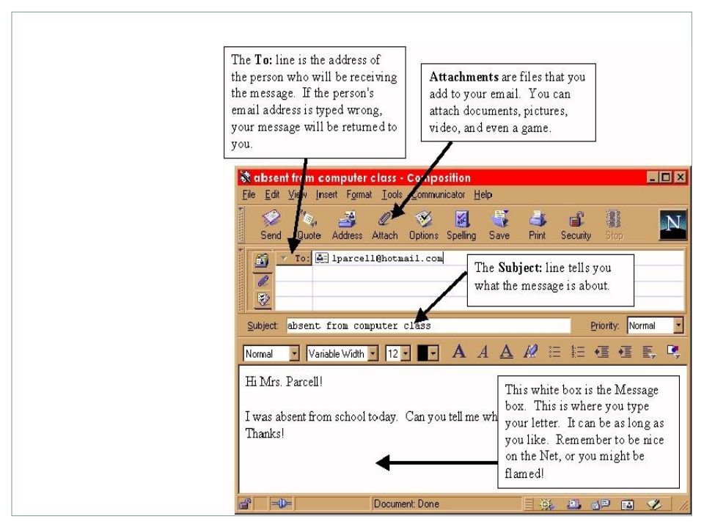
Elements of an Email
The TO Line
CC and BCC
The Subject Line
Attachment
Message box
Salutation
Body of email
Closure with signature
Parts
Of An
Email

Slide 7
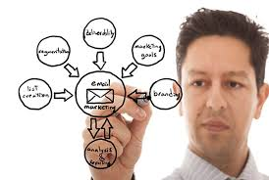
Role of Email Communication in Business
Formal communication
Email is quick or easy and costs low
Email communication is broadly
important for business growth
Maintains a connection with your
supporters
Keeps record of conversations

Slide 8
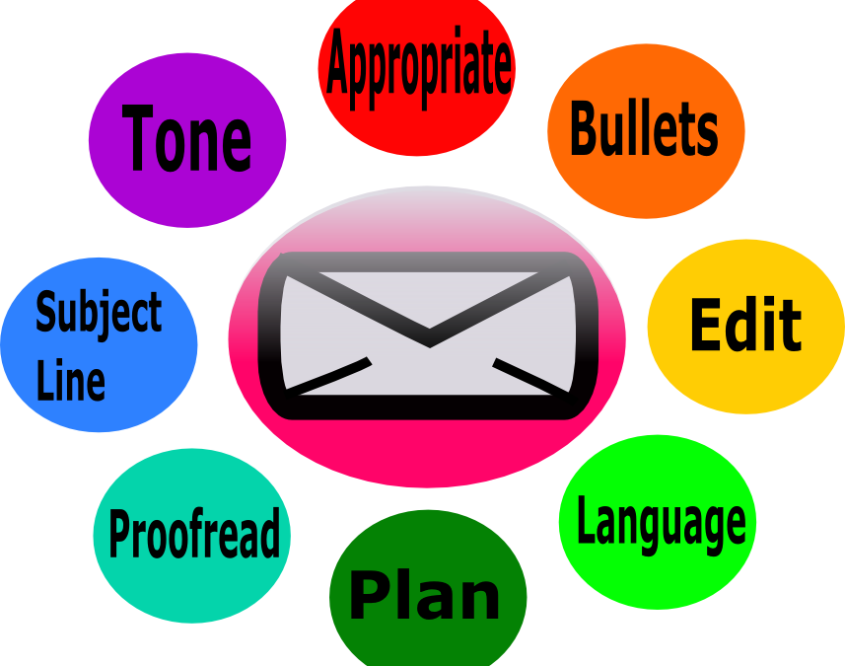
Email Etiquette- Definition
Email etiquette refers to the principles of behaviour that one should use when writing and answering email messages. It is also known as the code of conduct for email communication as it is less personal than phone or in-person conversation.

Slide 9
Steps for Writing Professional Email
1. Use a professional email address.
2. Have a compelling subject line.
3. Start with an appropriate greeting.
4. Have a strong attention grabber.
5. Keep your message concise.
6. Be consistent with your font.
7. Check the tone of your message.
8. Write a simple closing.
9. Use a professional signature
10. Use CC and BCC fields wisely.
11. Schedule your emails.
12. Do a final spelling and grammar check.

Slide 10
Email Etiquette
Email etiquette or rules are evolving because of our increased use of email. Some general etiquette should be observed.
Need of Email Etiquette for three reasons
Professionalism: by using proper email language your company will convey a professional image.
Efficiency: emails that get to the point are much more effective than poorly worded emails.
Protection from liability: employee awareness of email risks will protect your company from costly law suits.

Slide 11
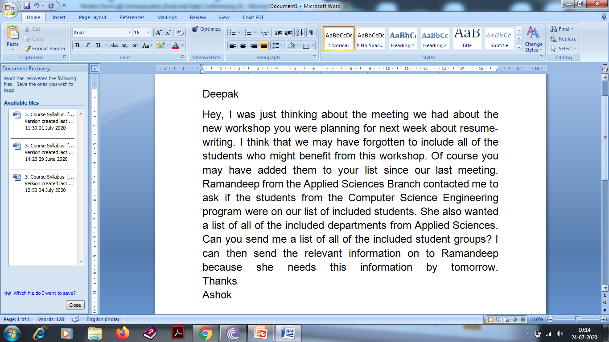
Poor Email Content
11

Slide 12
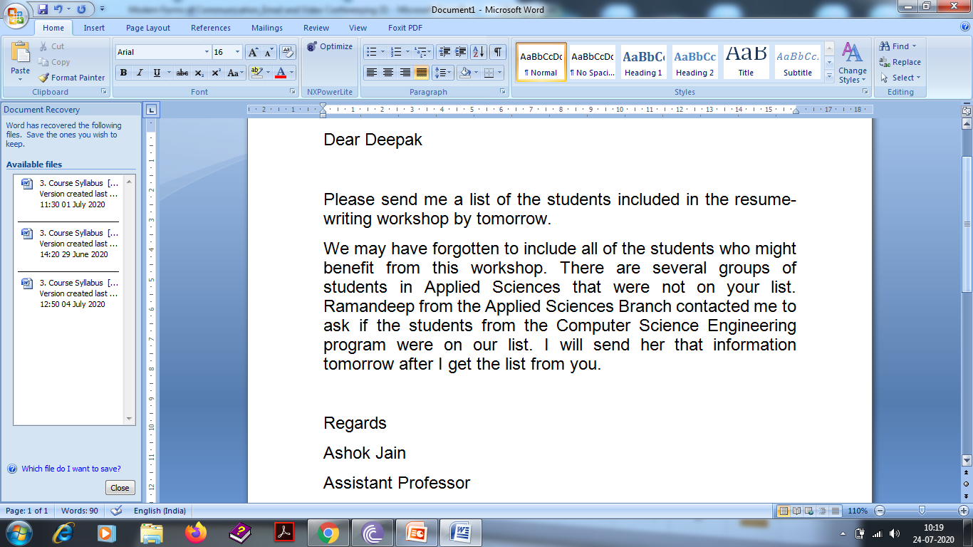
Better Email Content

Slide 13
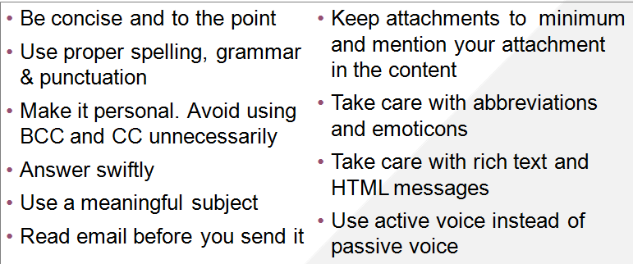
Email Etiquette Rules
Be concise and to the point
Use proper spelling, grammar & punctuation
Make it personal. Avoid using BCC and CC unnecessarily
Answer swiftly
Use a meaningful subject
Read email before you send it
Keep attachments to minimum and mention your attachment in the content
Take care with abbreviations and emoticons
Take care with rich text and HTML messages
Use active voice instead of passive voice

Slide 14

Poor Usage Examples
No subject line
Action required and key points
are hidden in the message
Misusing the global distribution list
Discussion that could have
been done over the phone

Slide 15
Use Smart Subject Lines
Poor Subject Line Examples
Weekly Minutes
Here are the URLs
Re: presentation
(blank subject line)
Unrelated subject line
sending an email with an old subject line

Slide 16
Use Smart Subject Lines
Good Subject Line Examples
FYI: Meeting minutes from 3/14 discussion
Reports Included: Minutes from MRM, all Reports due Friday 4/1
DISTRIBUTE: Program agenda & related information
Ramesh, Kirti: need you at noon meeting with your updates
AGENDA: Staff meeting Thurs 3/12 10:00 pm
Robin: I will attend the MRM & present summary. (EOM)

Slide 17
Think Before You Click
Don’t automatically “REPLY TO ALL”
Take one last look at your distribution list – is this email necessary for all recipients.
Eg. Welcome Mail – when replying, send it only to the person to be welcomed.
Once the email discussion goes beyond 2-3 replies anyway, it’s time to pick up the phone.

Slide 18
General Tips(FONTS)
- Use standard font throughout the message content
- Avoid coloured fonts in a professional email
Be very specific with the use of bold, italic or underline font style
Keep the size of the font visible and constant
Paragraph and line spacing should be legitimate and visually appealing
Avoid short forms or slang (e.g. ‘u’ instead of ‘you’, ‘y’ instead of ‘why’, ‘r’ instead of ‘are’, etc)

Slide 19
Assessment Pattern
Students are assessed on the basis of the following parameters:
Hourly Test- 2
Assignments
Surprise Test
Quiz
Engagement Task
End Semester Exam

Slide 20
References
https://jerz.setonhill.edu/writing/e-text/email/
https://www.indeed.com/career-advice/careerdevelopment/how-to-write-a-professional-email
https://turbofuture.com/internet/Disadvantages-of-Email
www.avispl.com/resources/‎
www.slideshare.net/bhunuzz/tele-conferencing-and-video-conferencing
Book Lesikar R.V., Petit J.D., Business Communication, Tata McGraw (2016), New Delhi.

